Slide 1
Energy Consumption Analysis
Mayank Raj Kolwal

Slide 2
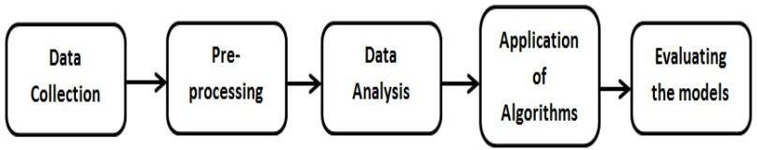
Methodology

Slide 3

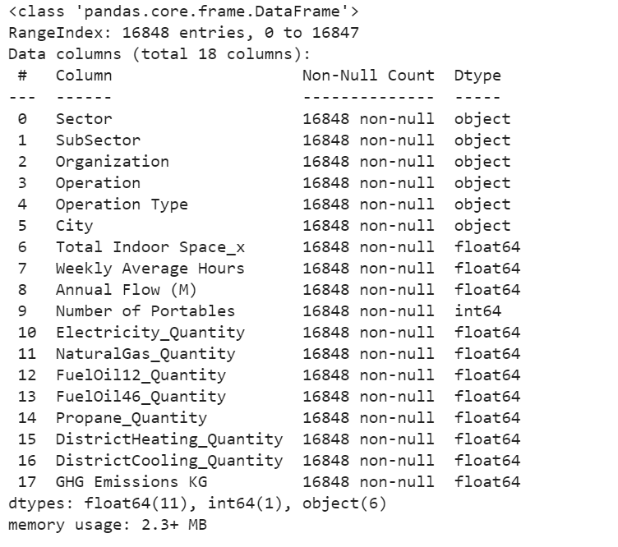



Data Set Overview

Slide 4
Data Pre-Processing
Data Cleaning
Statistical Analysis
Feature Construction
Identifying Outliers
Data Conversion
Collinearity Problem
Data Visualization

Slide 5

Data Cleaning

Slide 6
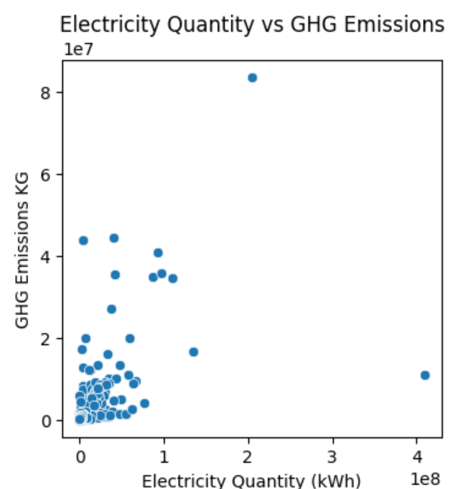
Statistical Analysis

Slide 7
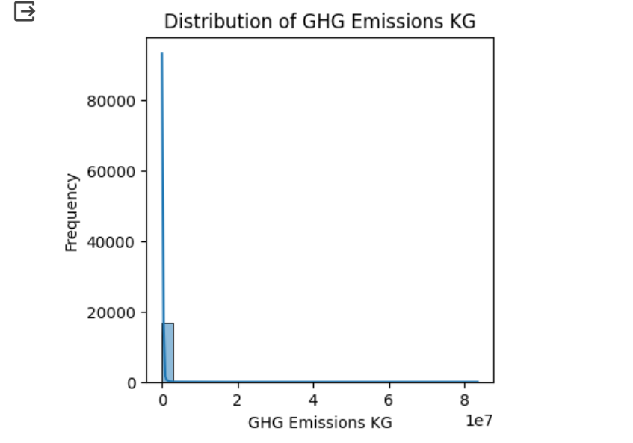
Frequency

Slide 8
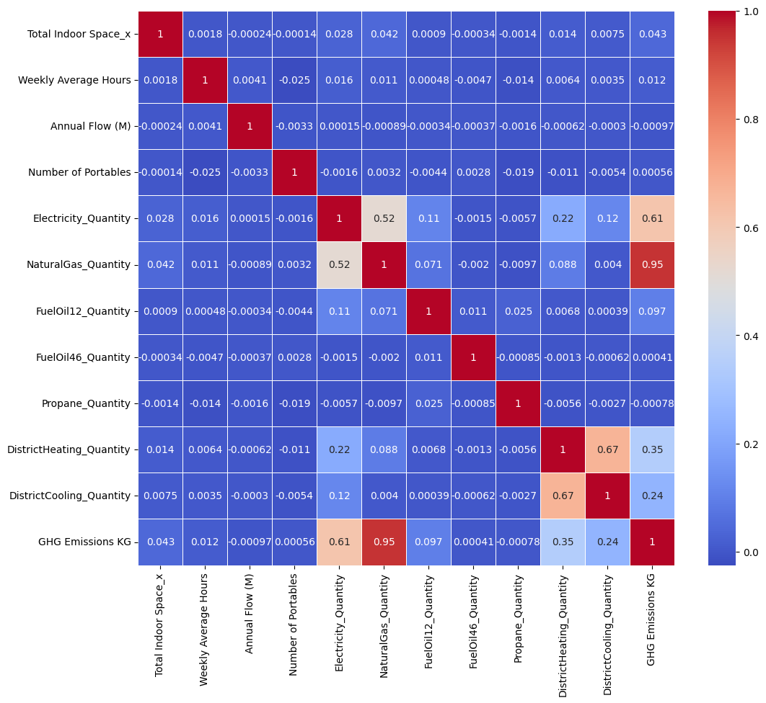
Correlation Among Features

Slide 9
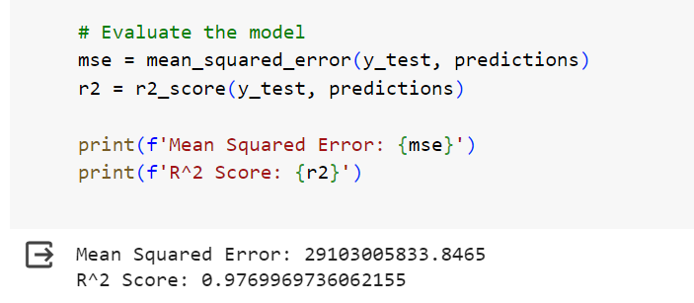
Models Evaluation based on manual tuning of hyper parameters

